Slide 1
Multi threaded applications in Java
  Java has the Thread class to support multithreaded applications
There are two ways to use the Thread class
  Extend the Thread class, implementing the “public static void run()” method
    The “public static void run()” method is where your program does its work
    The program that is using your class calls the Thread.start() method and that calls your run() method
  Implement the Runnable interface, implementing the “public static void run()” method
    The “public static void run()” method is where your program does its work
    The program that is using your class creates a Thread object wrapped around your Runnable object and then calls the Thread.start() method and that calls your run() method

Slide 2
Some methods in the Thread class
  start() - we don't implement this method, it calls our run() method
  static sleep(long milliseconds) - pauses the code
  static sleep(long milliseconds, int nanoseconds) - pauses the code
    Don't assume that this implies your computer's clock/timers can support nanosecond time resolution
  isAlive() - returns true if the Thread is still running, false if it is not
  join() - waits for the Thread to complete
  There are plenty of other methods
Note if you directly call the run() method, it will execute like a non-thread method
  That is, it will block the calling method until it completes

Slide 3
Simple example (no shared data)
We create a class that extends Thread, PrintToScreenThread, and a class that implements the Runnable interface, PrintToScreenRunnable
Both classes simply print a message to the screen a specified number of times with a specified delay between printing the message
Both classes have three fields
  name – to identify which copy it is
  delay – how long to pause between printing to the screen
  printCount – how many times to print the message
We should see the various messages interleaved based on the delay times for each thread

Slide 4
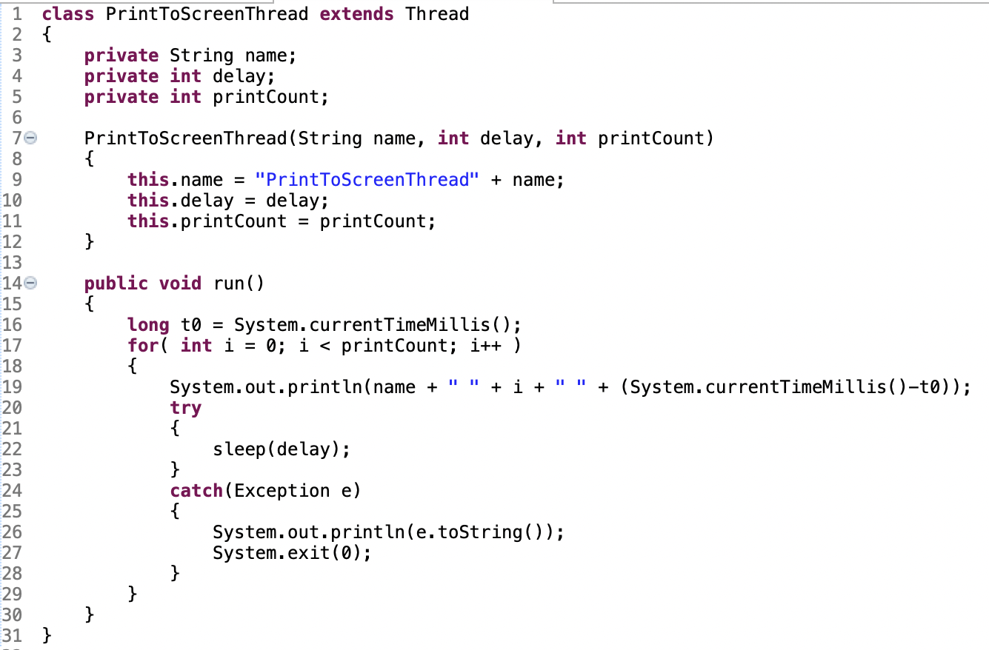
PrintToScreenThread

Slide 5
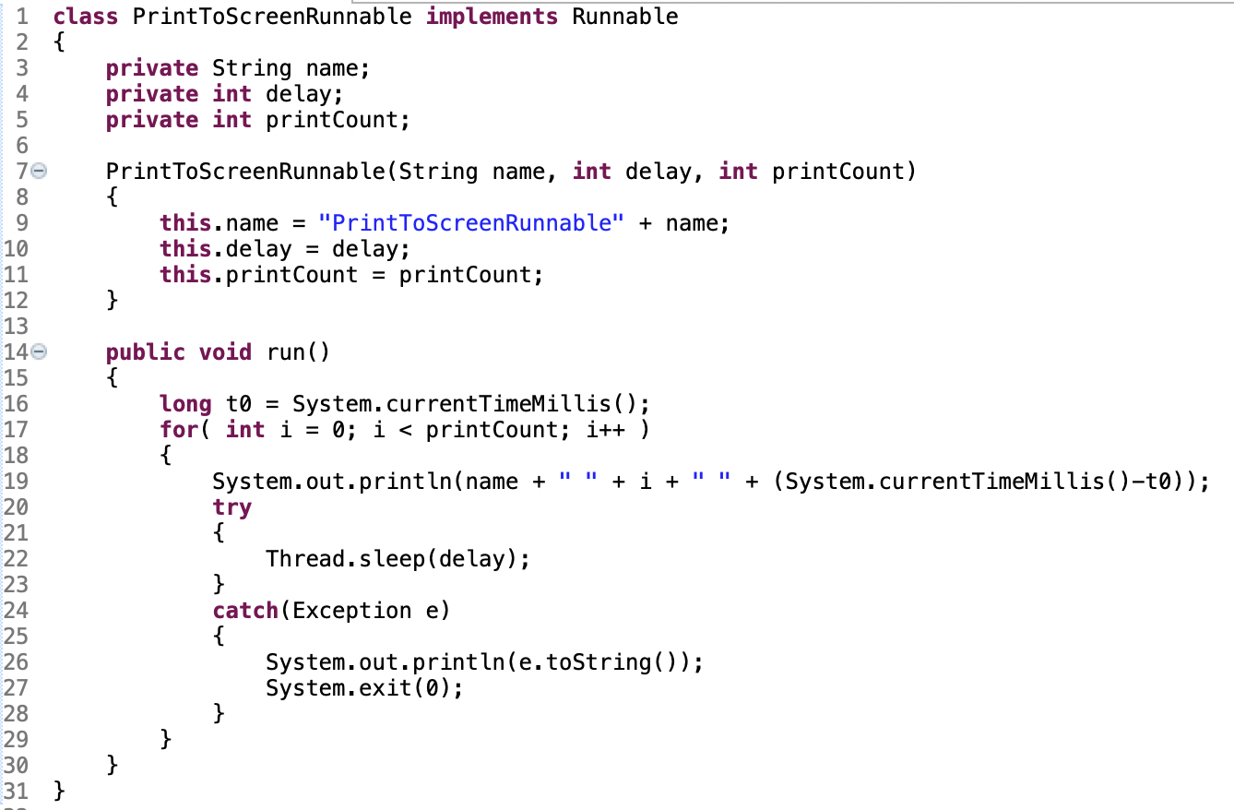
PrintToScreenRunnable

Slide 6
testThread.java
  Class to test out if our threads appear to be working
  It takes three command line parameters
    Number of threads and runnable threads
    How many iterations through the loop each thread does
    Optional – if the threads should be run as threads or non-threads
      Execute start() or run()
  The delay each thread uses for each iteration through the loop is increase by 100ms for each thread
    Thread 0 has no delay
    Thread 1 has 100ms delay
    Thread 2 has 200ms delay
    And so on
  The program allocates the threads and runnables, starts them running, and finally outputs when they are done running and how long they ran for

Slide 7
testThread.java
  Execute and discuss the output
  Briefly look at the code
  If we execute execute the threads as non-threads, execute Thread.run() or Runnable.run(), the threads run serially instead of in parallel
    We see that each one blocks while executing

Slide 8
Sharing data between threads
  If the shared data is created prior to the threads being instantiated and the shared data will not be updated by any class or thread, then there are no restrictions on accessing the data
    We don't need to ensure that only once class/thread is accessing the data at any time
  If the data is going to be accessed and updated by multiple threads at the same time, then we need to ensure that
    Only one thread is accessing the data at any time
    We want to ensure that when any class/thread is accessing the shared data, whether just reading or reading and writing, the entire operation is completed prior to any other class/thread accessing the shared data

Slide 9
Example of shared data mistake
  Let's say we have a multi threaded implementation of our BankAccount class (the BankAcount class just won't go away)
    The current savings balance is $100 for Jane Smith
    Thread A wants to deposit $10 to the savings balance of Jane Smith
    Thread B wants to deposit $20 to the savings balance of Jane Smith
    If they both attempt to make the update at the same time, what could happened
      Thread A and B both read the savings balance as $100
      Thread A updates it to $110
      Thread B updates it to $120
      And Jane Smith has now lost $10 due to our poor coding

Slide 10
There are multiple ways to ensure only one thread is accessing shared data at a time, one way is using a semaphore
The java.util.concurrent.Semaphore class can be used to ensure that a limited number of threads or classes can access a piece of shared data at the same time
  The semaphore allocates a number of “permits” that are available, and keeps track of how many “permits” are available and in use
  The simplest version is that exactly one thread/class can access the data at a time
    Serves as a mutually exclusive lock on the data
  We instantiate a Semaphore with a single permit with a fairness setting of true (permits are granted in first in first out order)

Slide 11
java.util.concurrent.Semaphore (cont)
  We use the acquire() method to get a permit to access the data
    This method blocks until a permit is available
    The tryAcquire() methods can be used for non-blocking
  We use the release() method to release the permit once we are done accessing the shared data
  Assuming a single permit semaphore, then when the acquire() method returns, your thread/class has exclusive access to the shared data and can read and write to it while other classes/threads wait to access it
  Once your thread/class has completed any updates or reads of the shared data, executing the release() method allows other classes/threads to access the shared data
There is a reduction in performance related to accessing shared data using a semapore (due to waiting for acquire())
  Takes additional time to get access the data

Slide 12
Simple example of use a Semaphore
  We have some shared data that we need to ensure only one class/thread accesses at a time
  We create a Semaphore with a single permit
  We give all of the classes and threads a copy of the semaphore that need access to the shared data
  Whenever a class/thread needs access to the data
    Execute Semaphore.acquire() to get a permit
    Access the data
    Execute Semaphore.release() to release the permit
  If we have a single permit, this scheme only allows a single class/thread access to the shared data at a time
Note a semaphore assumes all classes/threads that access the shared data properly implement the acquire()/release() pairs

Slide 13
Another way to provide shared data access is with Synchronized methods
  Only one thread/class can execute the method of the object at a time
  Simply add “synchronized” to the method declaration
  According to the java documentation, https://docs.oracle.com/javase/tutorial/essential/concurrency/syncmeth.html, for a given class, only one synchronized method can be executed at a time for a given object
    We need to ensure that all methods that access the shared data are synchronized
There is a reduction in performance related to accessing shared data via Synchronized methods (due to waiting for synchronized methods to execute)
  Takes additional time to access the data

Slide 14
Another way to provide shared data access is with a ReentrantLock
  From the Java documentation, https://docs.oracle.com/javase/7/docs/api/java/util/concurrent/locks/ReentrantLock.html
    A reentrant mutual exclusion Lock with the same basic behavior and semantics as the implicit monitor lock accessed using synchronized methods and statements, but with extended capabilities.
  Usage is similar to a semaphore
    Use lock() method to get exclusive access to the lock
      Blocks until the lock is available
    Use unlock() method to make the lock available to others

Slide 15
Another way to provide shared data access is with a ReentrantLock (cont)
  Usage is similar to a semaphore (cont)
    Use tryLock() to get the lock immediately if it is available
      Does not block if it is not available
    Use tryLock(long timeout, TimeUnit unit) to get the lock within the specified time
      Will block until timeout expires
  The java documentation recommends putting a try/finally block immediately after the lock() method call, with the code accessing the shared data in the try block, and the unlock() method call in the finally block
There is a reduction in performance related to accessing shared data using a lock (due to waiting for lock())
  Takes additional time to access the data

Slide 16
Sample code
  SimpleSharedClass.java
    Class with a single shared value, “value”, implementing the SimpleSharedClassFunctions interface, with no special handling of the shared value
  SimpleSharedClassSemaphore.java
    Class with a single shared value, “value”, implementing the SimpleSharedClassFunctions interface, using a semaphore to handle access to the shared value
  SimpleSharedClassLock.java
    Class with a single shared value, “value”, implementing the SimpleSharedClassFunctions interface, using a ReentrantLock to handle access to the shared value
  SimpleSharedClassFunctions.java
    Interface that specifies the functions applicable to the shared value
  SimpleSharedClassSync.java
    Class with a single shared value, “value”, implementing the SimpleSharedClassFunctions interface, using synchronized methods to handle access to the shared value
  SimpleSharedClassProcessor.java
    Class that extends Thread and in the run() methods makes updates to the shared value in the SimpleSharedClassFunctions class passed to it's constructor
  makeSimpleSharedClass.java
    Program that tests and shows the effect of not using a semaphore or synchronized methiods to access shared data

Slide 17
Sample code (cont)
  We have four classes, SimpleSharedClass, SimpleSharedClassSemaphore, SimpleSharedClassLock, and SimpleSharedClassSync that implement SimpleSharedClassFunctions and have a single field, “int value”, that is shared data across all threads that access the class
  The four classes implement four different versions of “protecting” the shared data from being accessed concurrently
  SimpleSharedClass.java
    Class with no special handling of the shared data “value”
    This is the wrong way to handle the shared data
  SimpleSharedClassSemaphore.java
    Class using a semaphore to handle access to the shared data “value”
  SimpleSharedClassLock.java
    Class using a lock to handle access to the shared data “value”
  SimpleSharedClassSync.java
    Class using synchronized methods to handle access to the shared data “value”

Slide 18
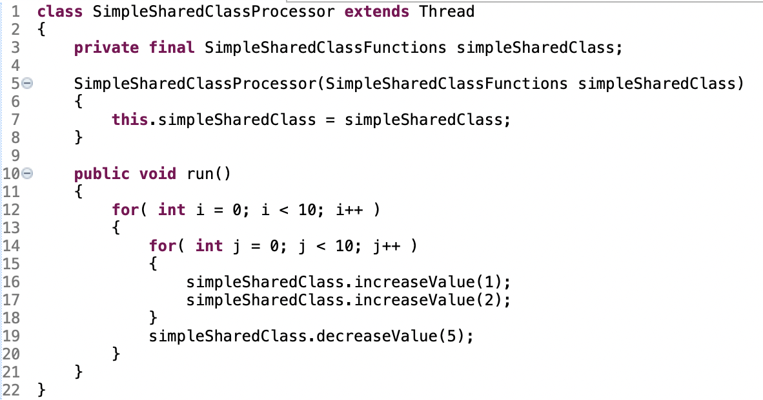
SimpleSharedClassProcessor
  This is the class that extends Thread and makes the method calls to the four versions of SimpleSharedClass to update the shared data
  Since the simpleSharedClass is of type SimpleSharedClassFunctions, the interface that the four classes implement, all four clases are of that type

Slide 19
makeSimpleSharedClass
  This program demonstrates how the shared data can be “corrupted” by not properly ensuring that only one thread or class is accessing the shared data at any time
  The program does the following
    Allocates a Semaphore for use by SimpleSharedClassSemaphore
      java.util.concurrent.Semaphore semaphore = new java.util.concurrent.Semaphore(1, true);
    Allocates a Semaphore for use by SimpleSharedClassLock
      java.util.concurrent.ReentrantLock lock = new java.util.concurrent.ReentrantLock(true);

Slide 20
MakeSimpleSharedClass (cont)
  The program does the following (cont)
    Instantiates an instance of each of the four SimpleSharedClass types {SimpleSharedClass, SimpleSharedClassSync, SimpleSharedClassSemaphore, SimpleSharedClassLock}
      SimpleSharedClass sharedClass = new SimpleSharedClass(delayInMilliSeconds, delayInNanoSeconds);
      SimpleSharedClassSync sharedClassSync = new SimpleSharedClassSync(delayInMilliSeconds, delayInNanoSeconds);
      SimpleSharedClassSemaphore sharedClassSemaphore = new SimpleSharedClassSemaphore(delayInMilliSeconds, delayInNanoSeconds, semaphore);
      SimpleSharedClassLock sharedClassLock = new SimpleSharedClassSemaphore(delayInMilliSeconds, delayInNanoSeconds, lock);

Slide 21
MakeSimpleSharedClass (cont)
  The program does the following (cont)
    Allocates four SimpleSharedClassProcessor arrays of size numberOfThreads
      SimpleSharedClassProcessor[] simpleSharedClassProcessor = new SimpleSharedClassProcessor[numberOfThreads];
      SimpleSharedClassProcessor[] simpleSharedClassProcessorSync = new SimpleSharedClassProcessor[numberOfThreads];
      SimpleSharedClassProcessor[] simpleSharedClassProcessorSemaphore = new SimpleSharedClassProcessor[numberOfThreads];
      SimpleSharedClassProcessor[] simpleSharedClassProcessorLock = new SimpleSharedClassProcessor[numberOfThreads];

Slide 22
MakeSimpleSharedClass (cont)
  The program does the following (cont)
    Instantiates each array element for each of the four SimpleSharedClassProcessor arrays, with each array element of each of the four arrays sharing a copy of the appropriate object
    for( int i = 0; i < simpleSharedClassProcessor.length; i++ )
    {
      simpleSharedClassProcessor[i] = new SimpleSharedClassProcessor(sharedClass);
      simpleSharedClassProcessorSync[i] = new SimpleSharedClassProcessor(sharedClassSync);
      simpleSharedClassProcessorSemaphore[i] = new SimpleSharedClassProcessor(sharedClassSemaphore);
      simpleSharedClassProcessorLock[i] = new SimpleSharedClassProcessor(sharedClassLock);
    }
    Each array element of each of the four arrays is wrapped around the same class/object

Slide 23
MakeSimpleSharedClass (cont)
  The program does the following (cont)
    Start each Thread running
    for( int i = 0; i < simpleSharedClassProcessor.length; i++ )
    {
      simpleSharedClassProcessor[i].start();
      simpleSharedClassProcessorSync[i].start();
      simpleSharedClassProcessorSemaphore[i].start();
      simpleSharedClassProcessorLock[i].start();
    }
    And then waits for each of the threads to complete running
      The code is checking to see when all of the copies of each array all return false to isAlive() for the first time
      When the above first happens, the program outputs that the array has completed

Slide 24
MakeSimpleSharedClass (cont)
  Running and the expected output
  Since SimpleSharedClassProcessor increases “value” by 1 and 2 ten times in the inner loop, and decrease it by 5 in the outer loop, and the outer loop executes 10 times
  value increase by (1 + 2) x 10 = 30 in the inner loop
  value decreases by 5 in the outer loop
  The outer loop is executed 10 times, so value is incresed by 10 x 30 and decreased by 10 x 5
  So, value is increased by 300 – 50 = 250 in each Thread for each of {SimpleSharedClass, SimpleSharedClassSync, SimpleSharedClassSemaphore, SimpleSharedClassLock}
  Since there are 10 threads per class, that means each class should end with value = 2500
  Running is simple “java SimpleSharedClassProcessor”

Slide 25
MakeSimpleSharedClass (cont)
  Output from “java SimpleSharedClassProcessor”
    the correct output should be value = 2500
    sharedClass.toString() value = 241 (266ms)
    sharedClassSync.toString() value = 2500 (2648ms)
    sharedClassLock.toString() value = 2500 (2654ms)
    sharedClassSemaphore.toString() value = 2500 (2654ms)

Slide 26
MakeSimpleSharedClass (cont)
  What the output is telling us
    sharedClass.toString() value = 241 (266ms)
      The 10 threads associated with SimpleSharedClass took 266ms to execute, and ended with value = 241
      We got the wrong result, but we got it pretty quickly
    sharedClassSync.toString() value = 2500 (2648ms)
      The 10 threads associated with SimpleSharedClassSync took 2648ms to execute, and ended with value = 2500
      We got the correct result, but it took a little longer than getting the incorrect result
    sharedClassLock.toString() value = 2500 (2654ms)
      The 10 threads associated with SimpleSharedClassSync took 2654ms to execute, and ended with value = 2500
      We got the correct result, but it took a little longer than getting the incorrect result
    sharedClassSemaphore.toString() value = 2500 (2654ms)
      The 10 threads associated with SimpleSharedClassSync took 2654ms to execute, and ended with value = 2500
      We got the correct result, but it took a little longer than getting the incorrect result

Slide 27
Some final thoughts
  Using synchronized methods is quite easy to use, simply add “synchronized” to the methods that access the shared data
    This will block access to the other synchonized methods for the entire time that the method is executing
  Using a Semaphore we can have multiple methods executing that access the shared data, but the portion that access and uses the shared data needs to use the Semaphore to ensure only one thread/class is accessing the shared data at a time
    The code needs to correctly implement the acquire/release pairs and enforce not accessing the shared data without a “permit”

Slide 28
Some final thoughts (cont)
  Using a ReentrantLock we can have multiple methods executing that access the shared data, but the portion that access and uses the shared data needs to use the ReentrantLock to ensure only one thread/class is accessing the shared data at a time
    The code needs to correctly implement the lock/unlock pairs and enforce not accessing the shared data without the lock

Slide 29
Summary of what we did
  For each of {SimpleSharedClass, SimpleSharedClassSync, SimpleSharedClassSemaphore, SimpleSharedClassLock}
    We created 10 threads that access the shared data “value”
    Each thread modified “value” using the increaseValue() and decreaseValue() methods
    Since SimpleSharedClass did not do anything to ensure only one thread modified “value” at a time, at the end of execution, “value” had the incorrect value
    Since SimpleSharedClassSync, SimpleSharedClassSemaphore, and SimpleSharedClassLock used synchronized methods, a semaphore, and a reentrant lock to ensure only one thread accessed “value” at any time, at the end of execution, “value” had the correct value

Slide 30
Some other thoughts/questions
  What would happen if a synchronized method in class A calls another synchronized method in class A?
    What if it is a different instantiation of A?
  What would happen if a synchronized method in class A calls a synchronized method in class B?
    What if a synchronized method was alreading executing in class B?
    What if the synchronized method in class B was waiting for a different synchronized method in class A to complete?
  What if just one method in class A that accesses shared data doesn't acquire a “permit” prior to accessing the shared data?

Slide 31
java.util.concurrent.locks
  The java documentation, https://docs.oracle.com/javase/7/docs/api/java/util/concurrent/locks/package-summary.html, has additional information on locks
java.util.concurrent.atomic
  The java documentation, https://docs.oracle.com/javase/8/docs/api/java/util/concurrent/atomic/package-summary.html, has information on classes that support single variable multiple thread access without using locks

